Slide 1
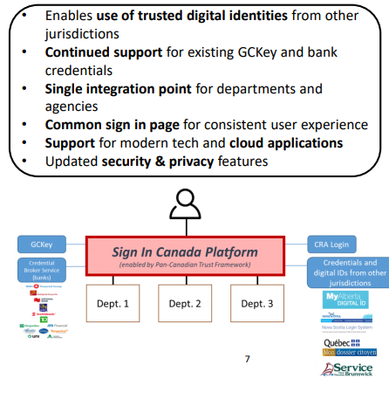
Sign in Canada
A whirlwind tour of improving DevOps and automation practices

Slide 2
Opportunities
Consistency, openness increases inclusiveness
Avoid lock-in, use standards focus for interoperabilty
Pipelines support build automation, security scanning
Reproducible builds in environments designed for scaling
More code and processes, fewer documents
Agile to build robustly what the present needs and adjust when required

Slide 3
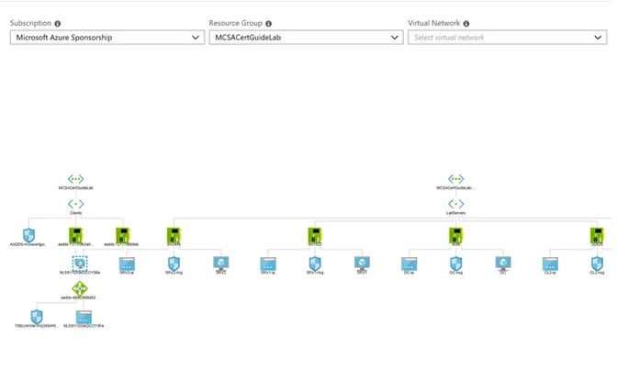

Challenges & learning ops
Small team
Established practices, velocity
Making work accessible for all team members
Project is in motion
Changing priorities, diversions
Inherited technical structure
GLUU forked repos, modules also in motion
Uses containers in Virtual Machines
Within IMTD, GC
Differences between Azure and IMTD practices, “usual” projects
Balancing open and secure
Emphasis on documents in GC
Best practices are extensive and evolving - ossf/scorecard: Security Scorecards - Security health metrics for Open Source (github.com)

Slide 4
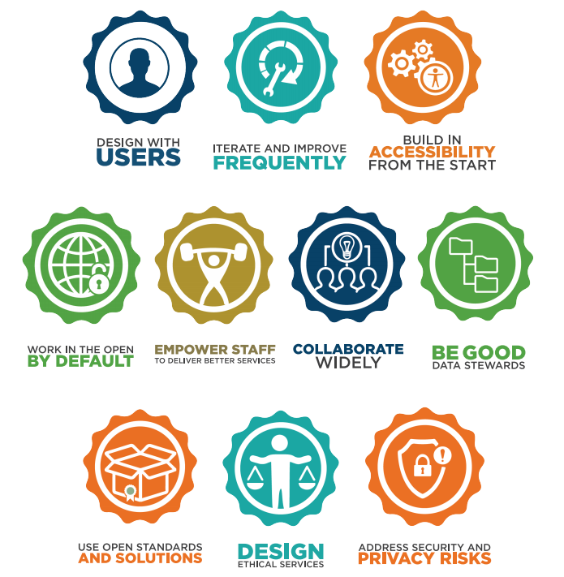

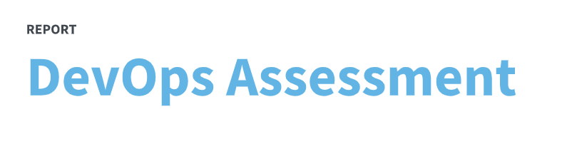
Alignment to Digital Standards
GoC Digital Standards

Slide 5
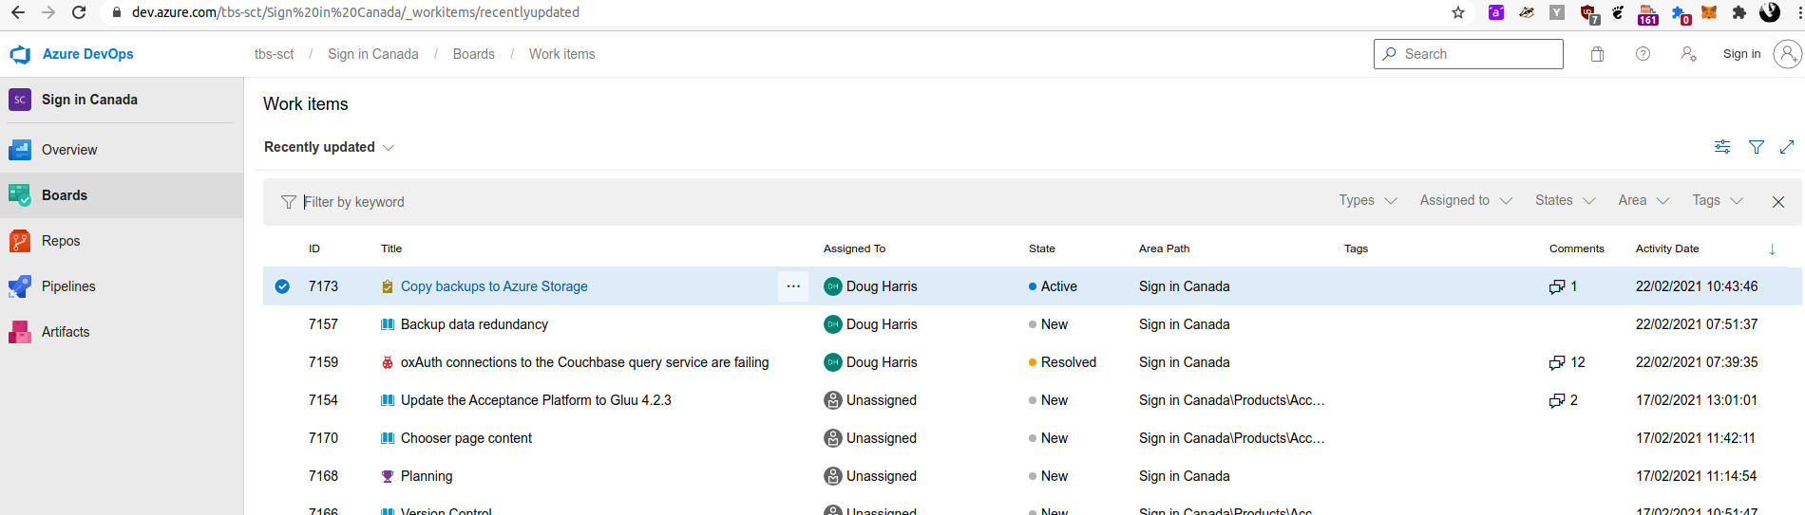
More open
Since the Fall, migration from private project tracking to a world-readable Azure Devops site, linked to open GitHub repositories, and improved repository processes and conventions.

Slide 6
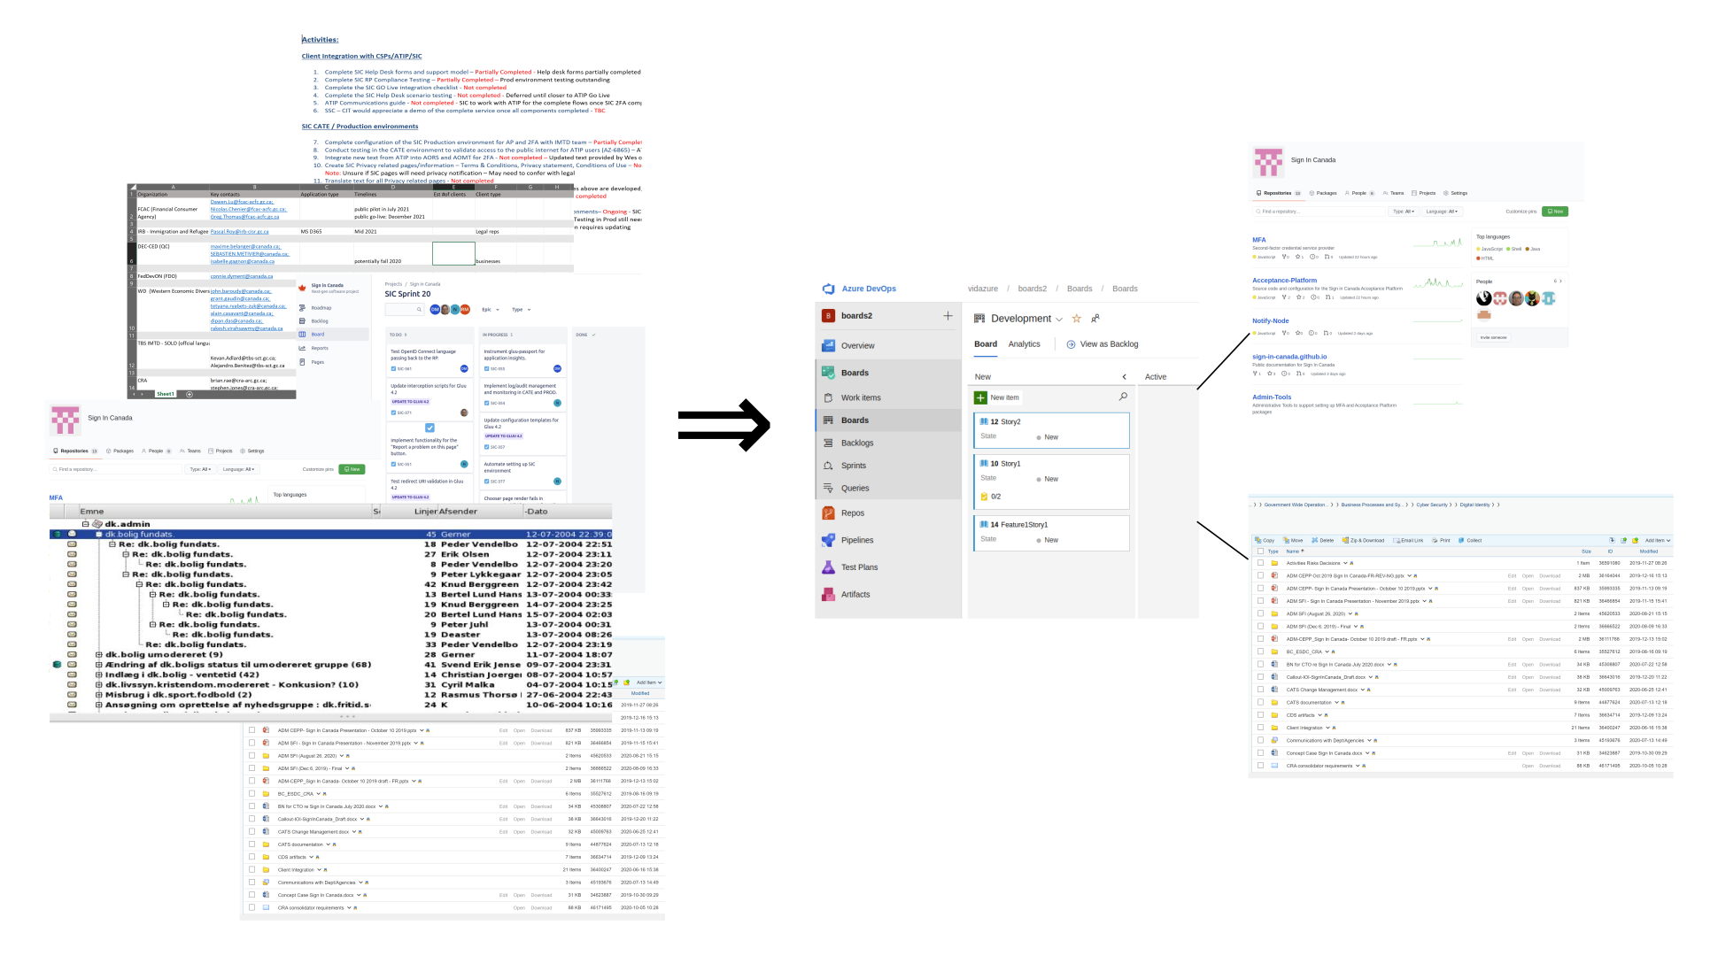
Organizing in Azure DevOps
Issues - Support more structure, linking
Pipelines - support move to continuous integration/deployment
Wiki - summarize and link to the most important information in a more organized, accessible way; document key procedures, that are followed from the wiki each time with on the spot updating. Wiki supports markdown based diagrams, which are easier to update
Integrated project management including opportunities to script reports

Slide 7
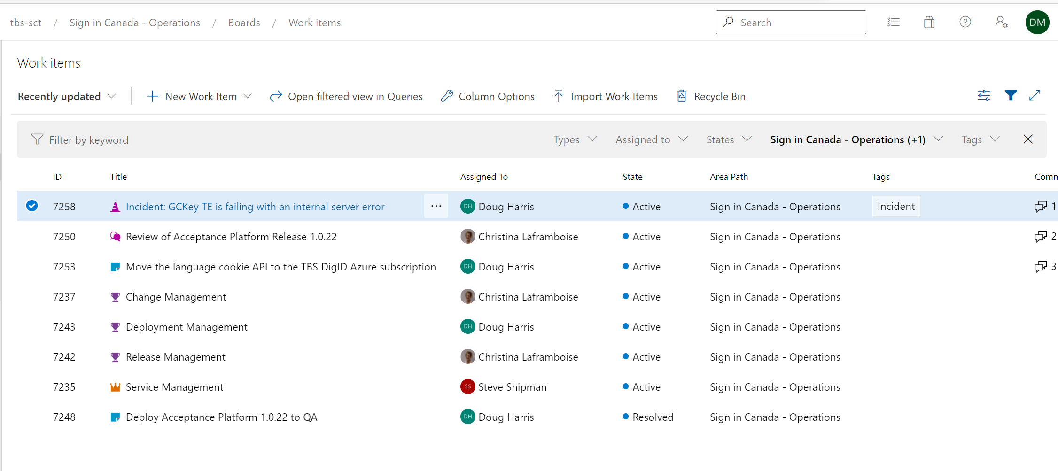
More transparent
Private Operations DevOps project, participants can be invited

Slide 8
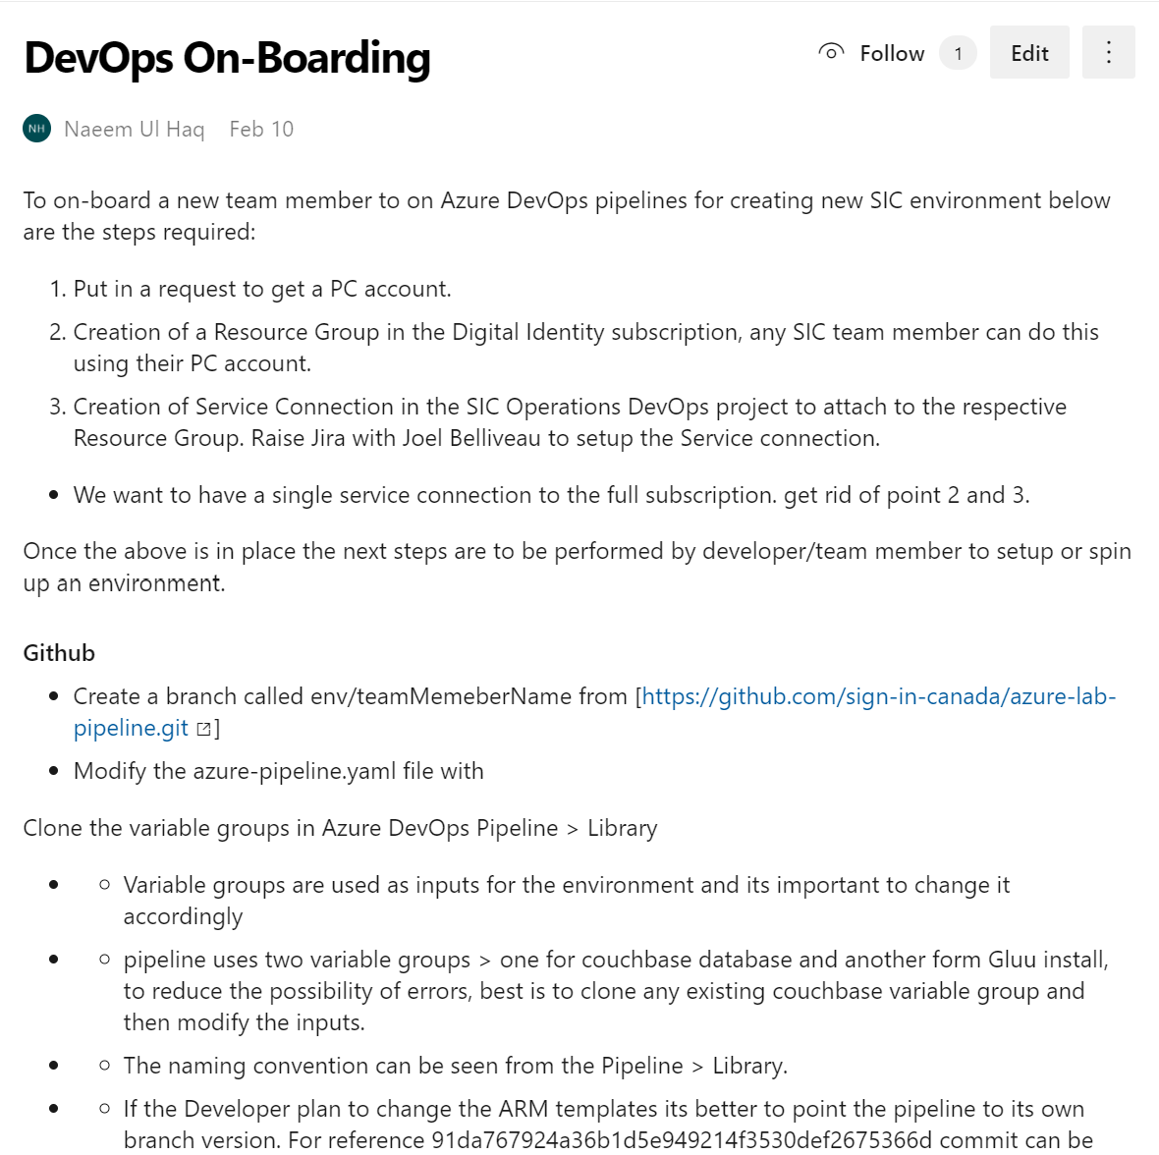
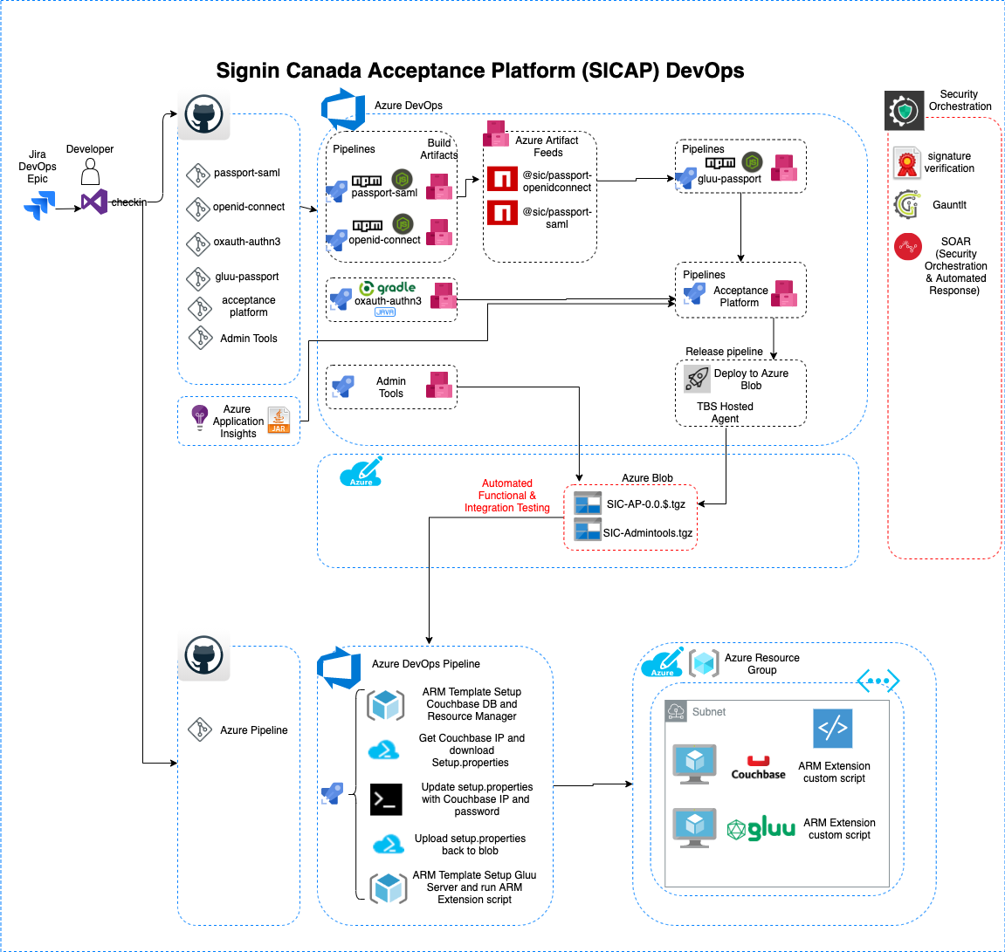
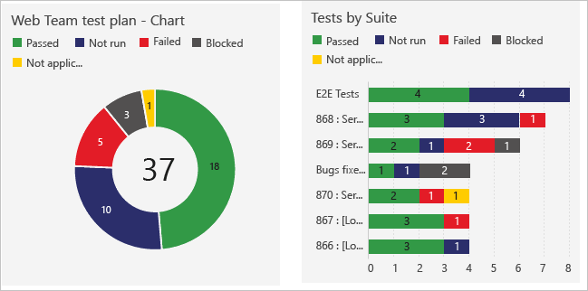
Pipeline

Slide 9
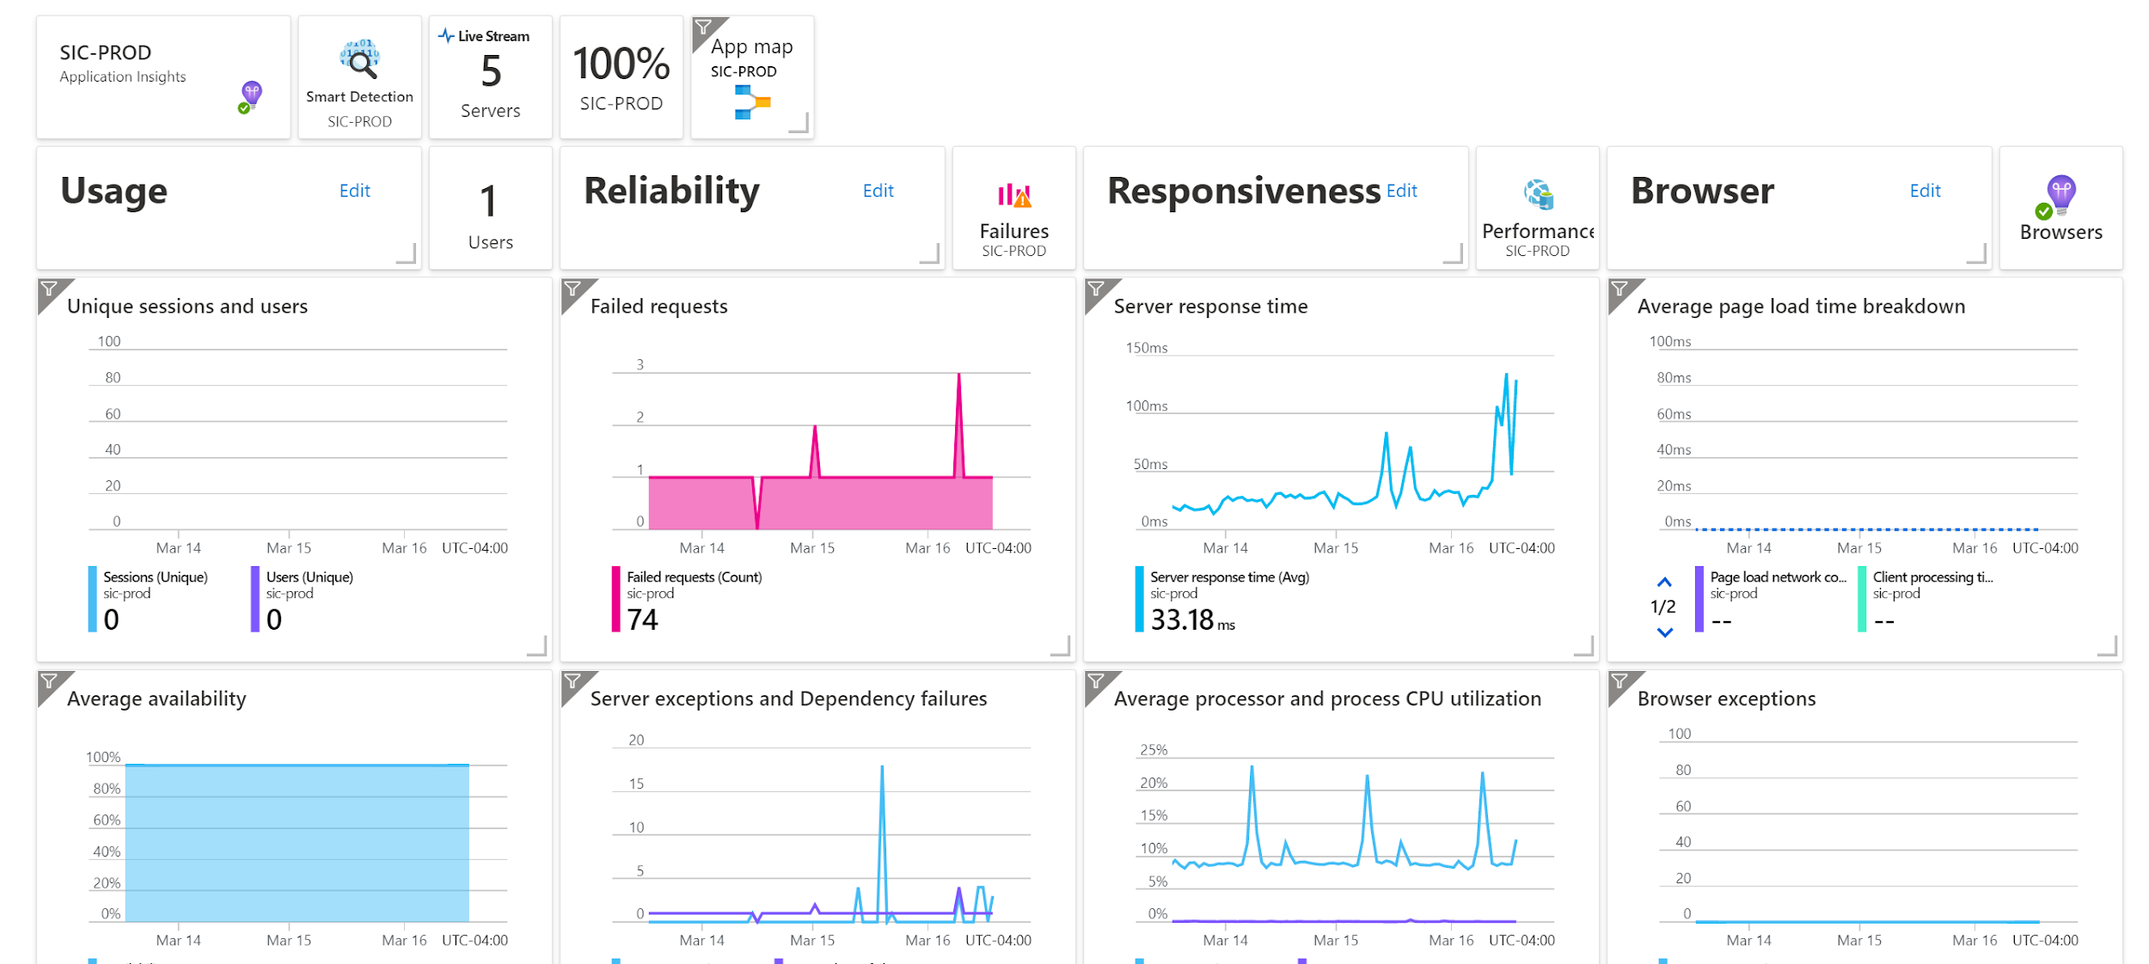
Consolidating logging and monitoring

Slide 10
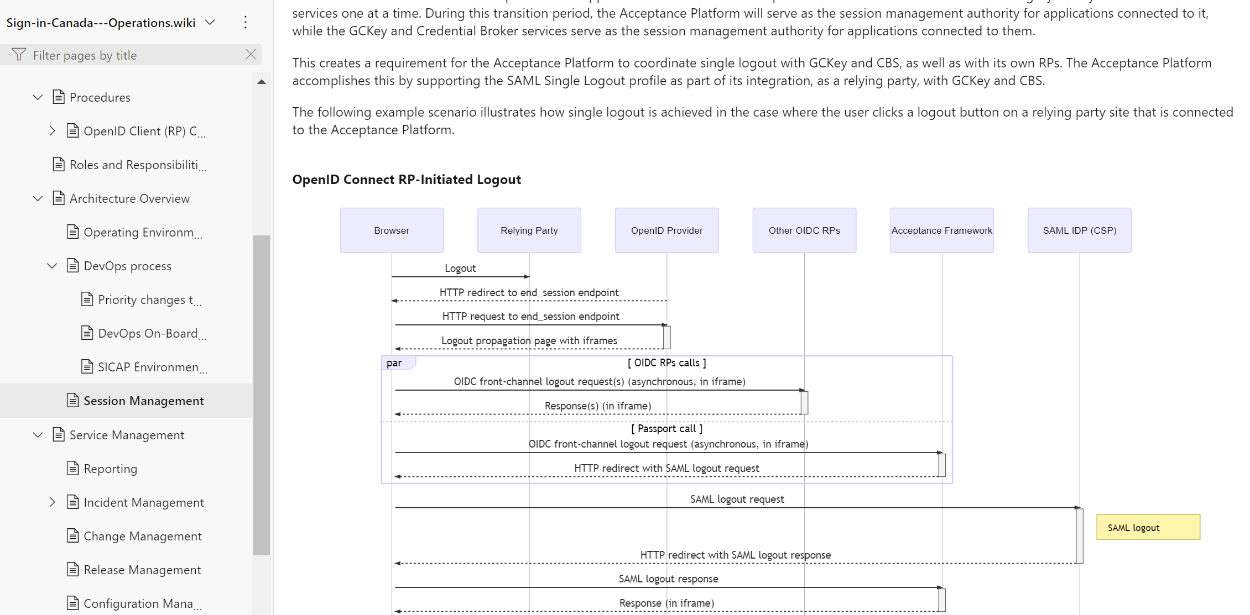
Wiki

Slide 11
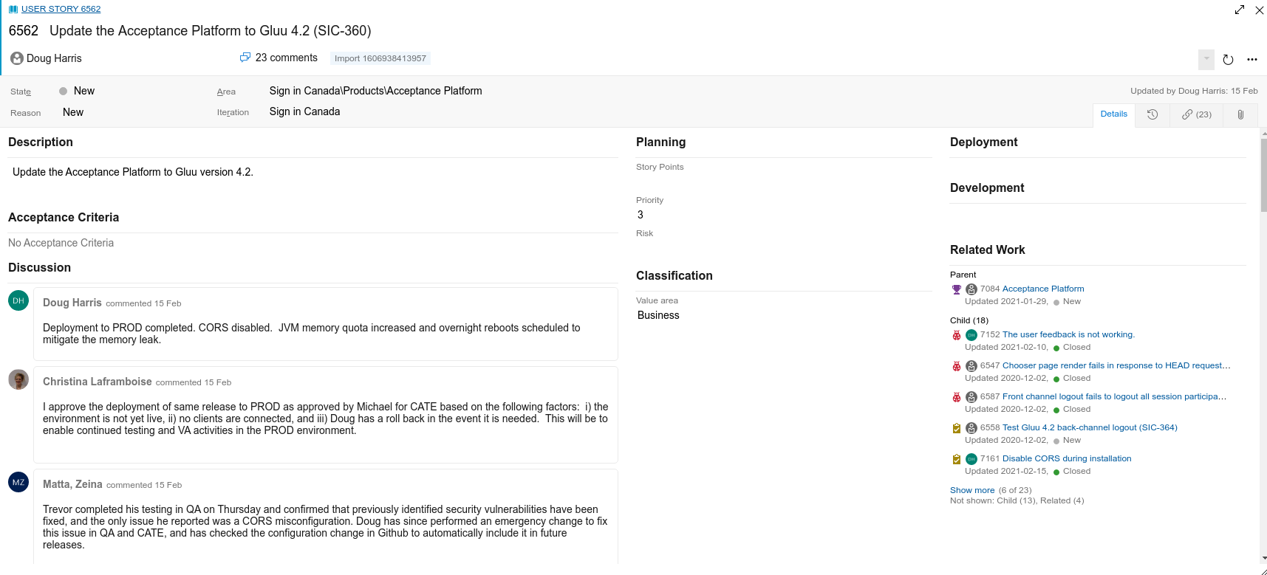
Change Management

Slide 12
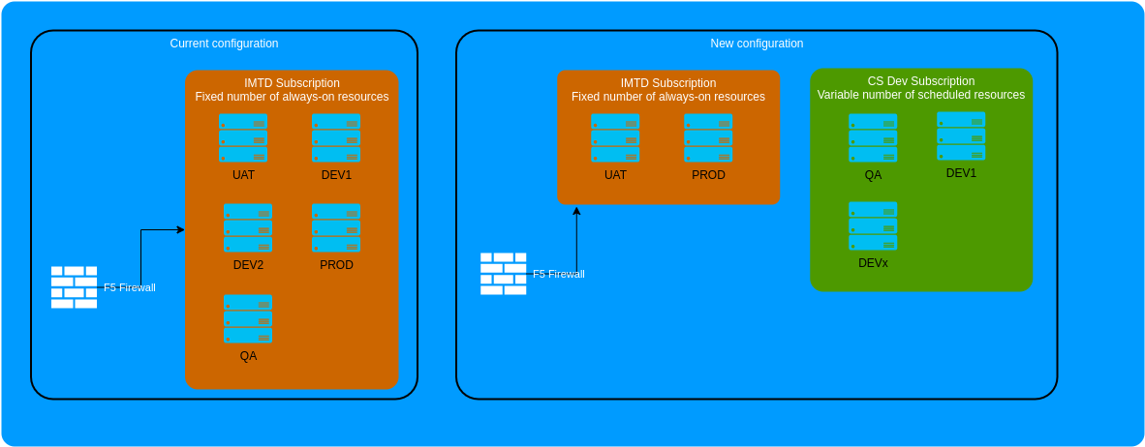
Optimizing infrastructure
Reorganized from fixed IMTD resources to dynamic resources, with a reduced net cost
Working toward “infrastructure as code” using Azure Pipelines
Vastly improved developer experience

Slide 13
Continuing
Better integrated security scanning
“Shift left” unit tests in individual repos
Keep improving wiki documentation
Script higher level reports like client activities, onboarding
Deployment via Azure Pipelines
Provide clients direct access to DevOps issues, Azure statistics
Follow GLUU in adopting Docker or Kubernetes instead of VMs
Finer linking of Github to Azure Devops
End to end testing

Slide 14
Test Automation
A key requirement of modern software
Ad-hoc from developer workstation (per commit), integrated in pipeline

Slide 15
Test Automation - Sign in Canada challenges
Sign in Canada is highly distributed, with many paths
Multiple sessions on a shared computer with multiple identity providers
Every supported browser and device

Slide 16
Test Automation - E2E tests
End to End testing
Modern E2E frameworks - browser based - Playwright, or distributed - Selenium - Codeceptjs - evergreen, depth
Automated tests working shoulder to shoulder with humans
Many tests, many devices (browser types, device metrics, geolocation, orientation, etc) in a short period of time, including corner cases (extensions!!!)
Constantly expanding breadth of tests
Enable humans to test trickiest cases, define new automated tests
Can run tests against any conformant stack with small changes

Slide 17
Test Automation - Behaviour (specification) Driven
Use human language to define tests
Efficiency and maintainability of library of reusable phrases
https://github.com/sign-in-canada/bdd-tests

Slide 18
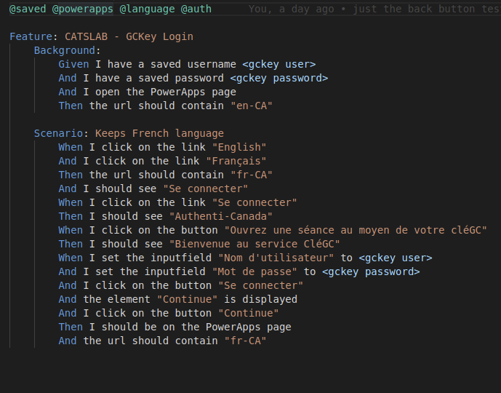
Test Automation - BDD Example

Slide 19

Test Automation - Demo

Slide 20
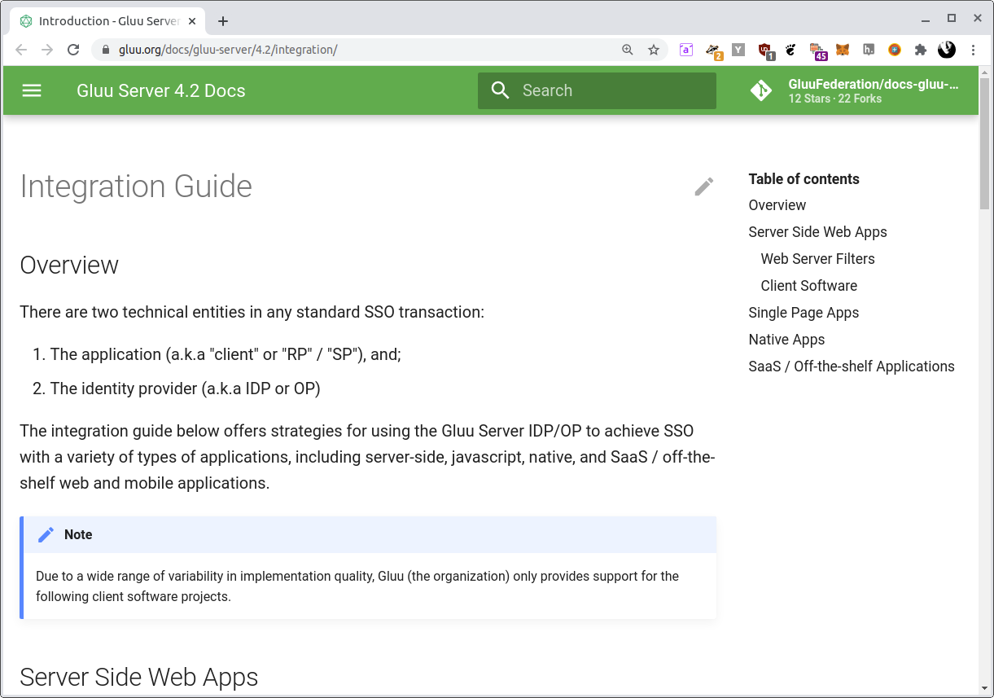
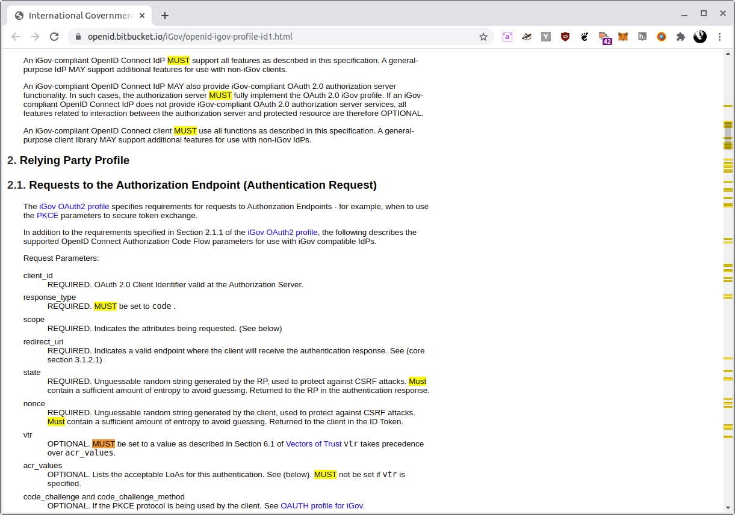
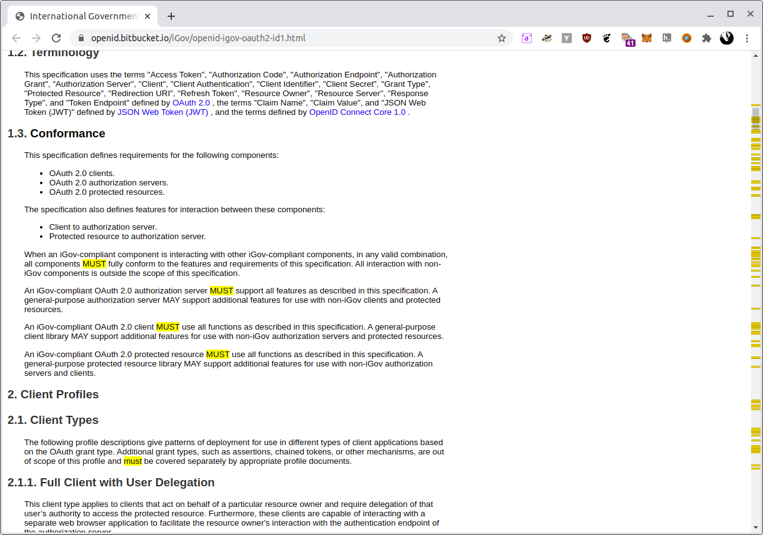
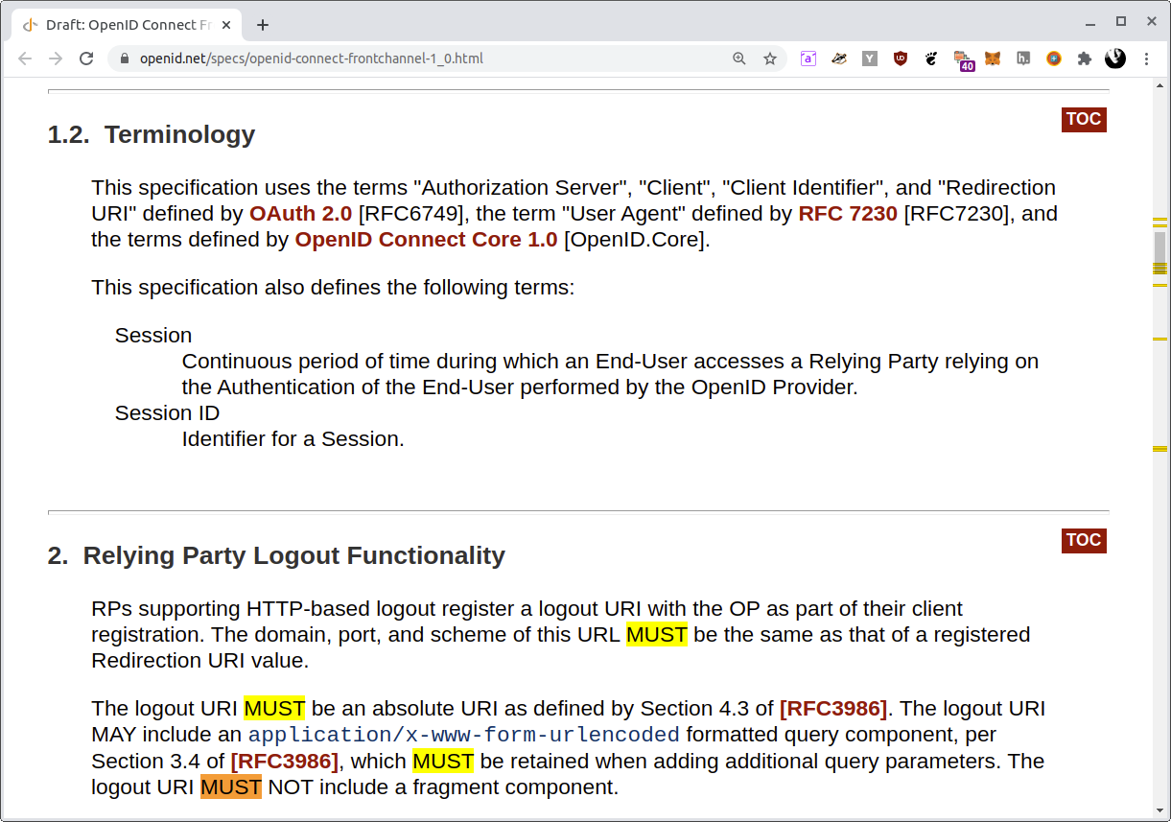
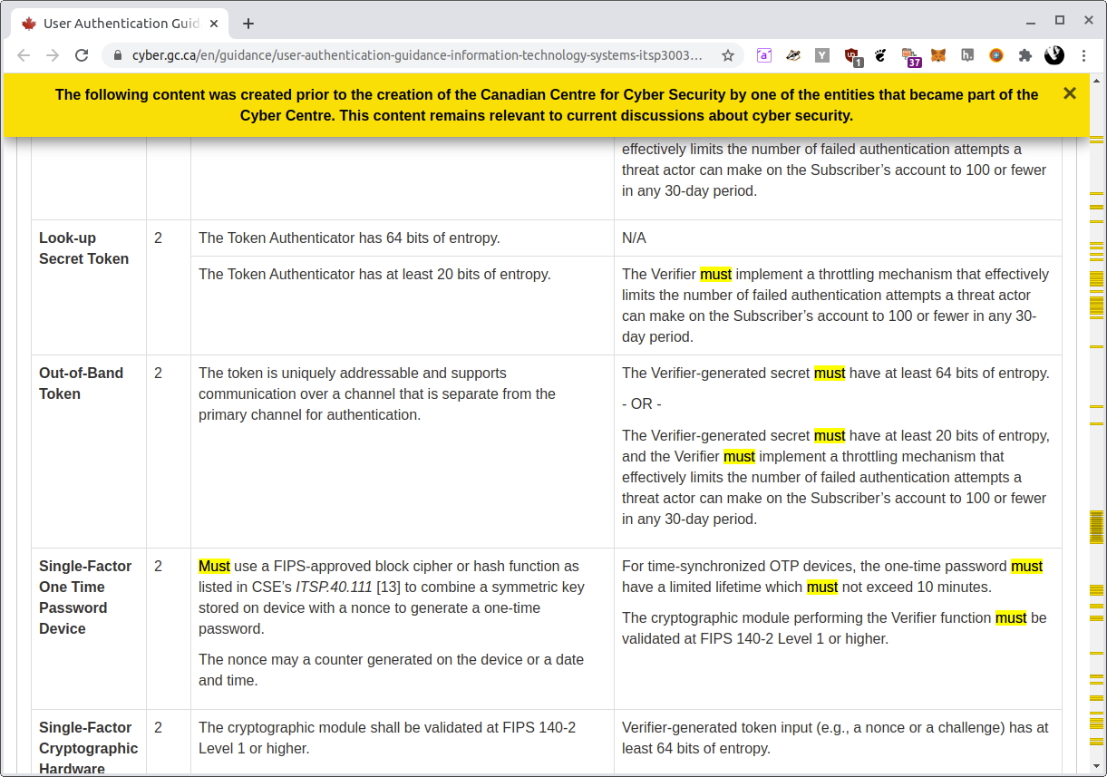
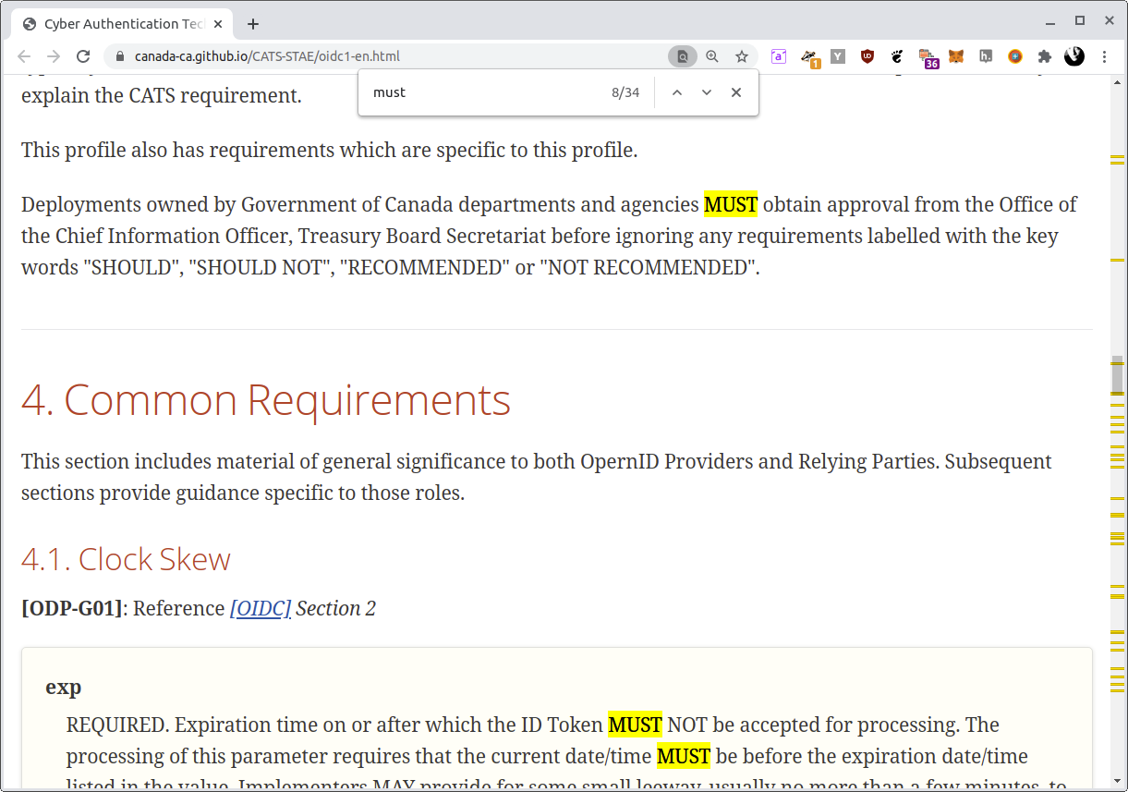
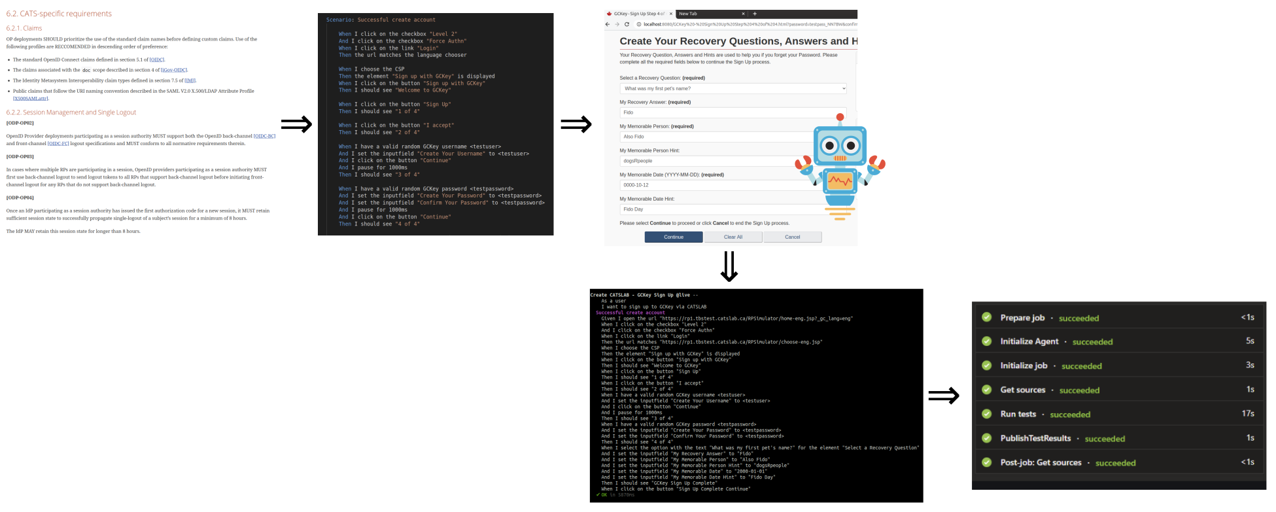
Test automation - what’s next?
Extract conformance keywords (“MUST,” etc) from linked specification documents
Broken test cases can link directly into the specification

